Slide 1

State Management
Bernhard Mayr May ‘25

Slide 2

Table of Content
Functions
MV(C|P|I|VM)
Reactive Programming
Flux, Redux, Elm
RemoteData<S, E>
Signals
Statecharts
https://github.com/bemayr/state-management

Slide 3

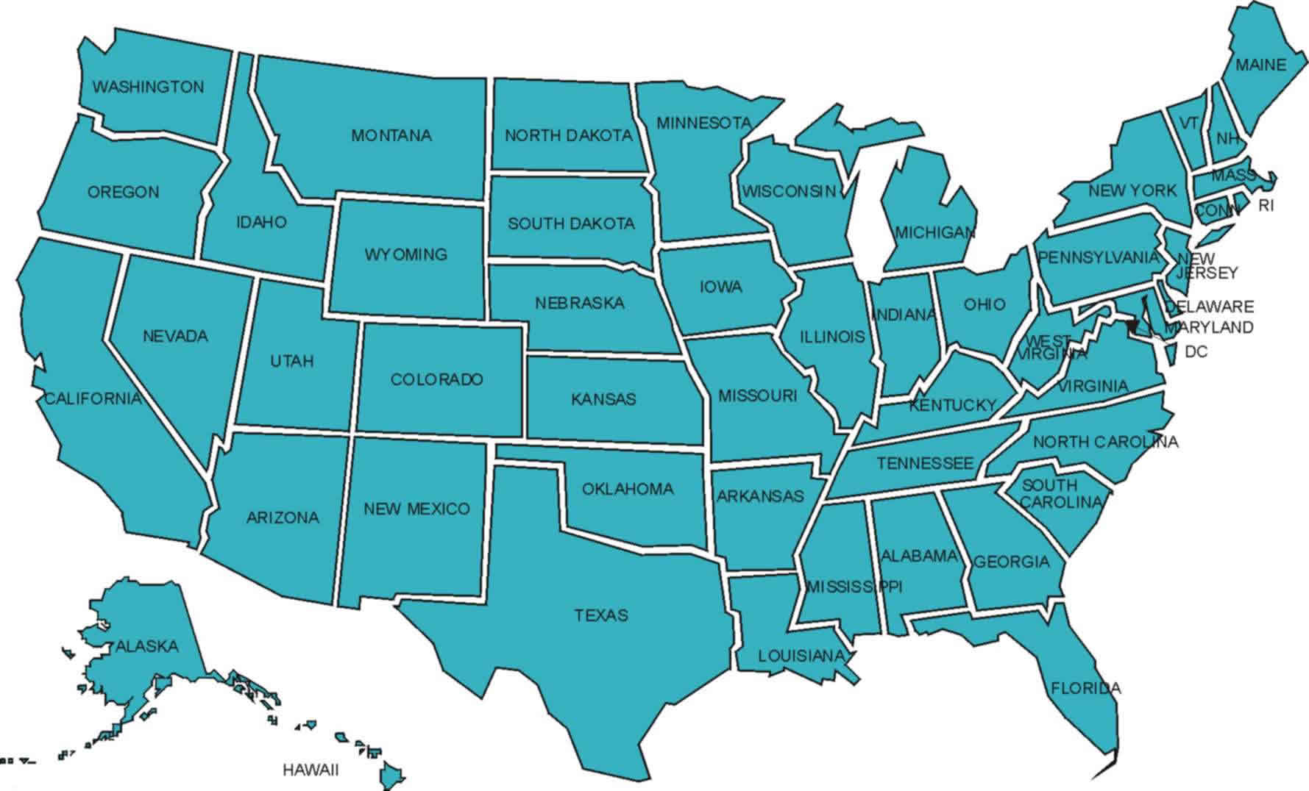
State
Management

Slide 4
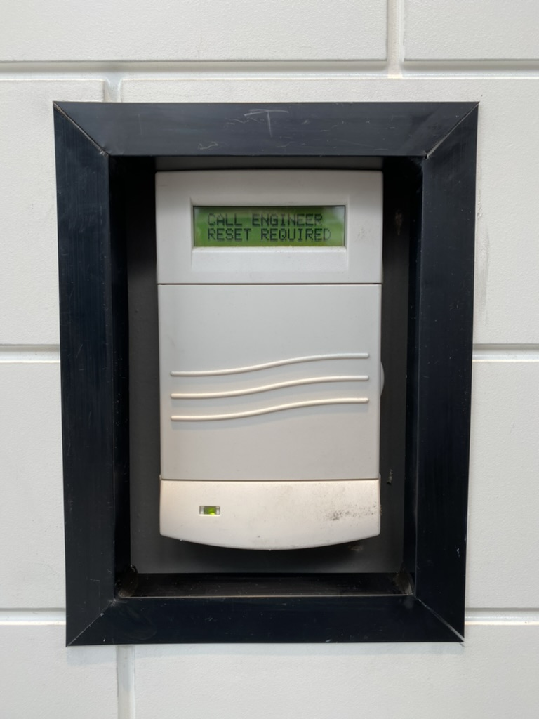


Slide 5
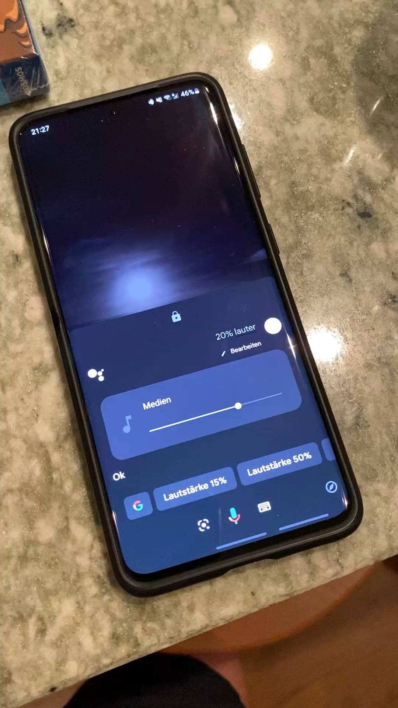

Slide 6
